Slide 1
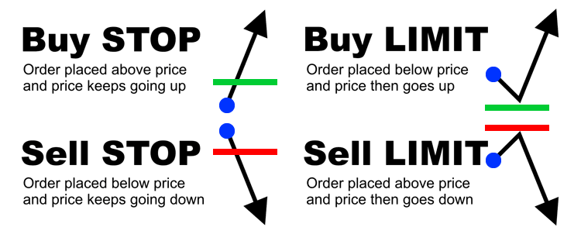
Order Types in MetaTrader
01) Market Orders
an order instantly executed against a price that your broker has provided.
02) Pending Orders
an order to be executed at a later time at the price you specify.

